Slide 1
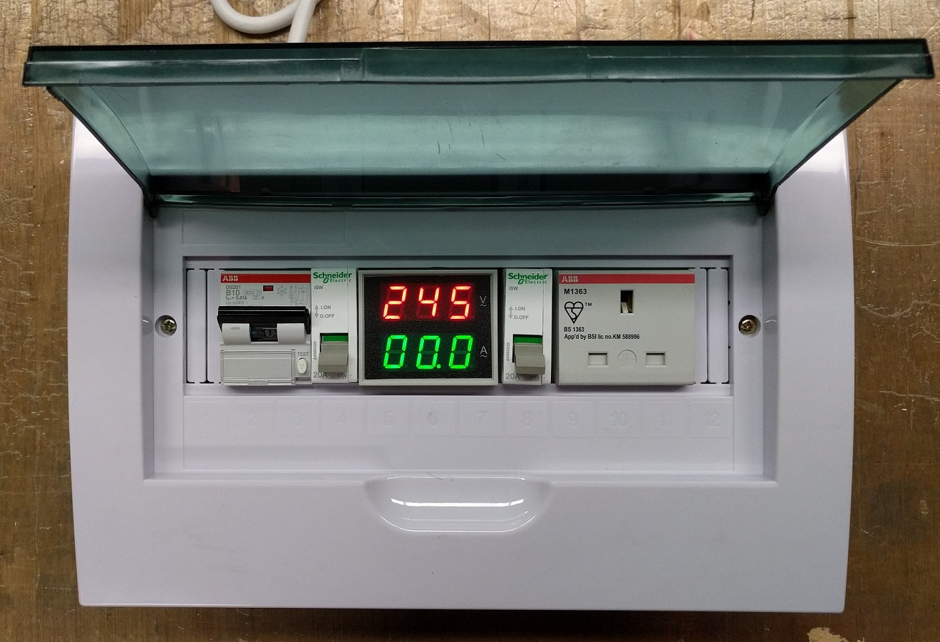
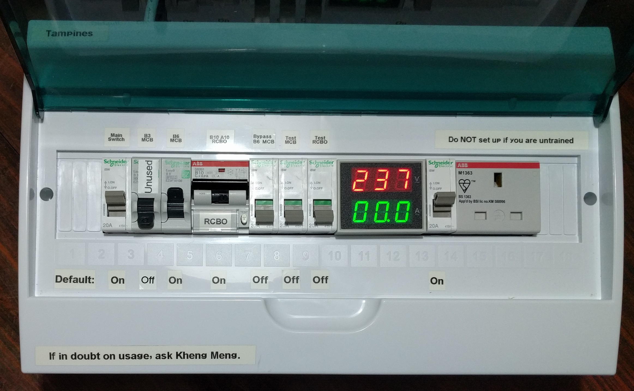
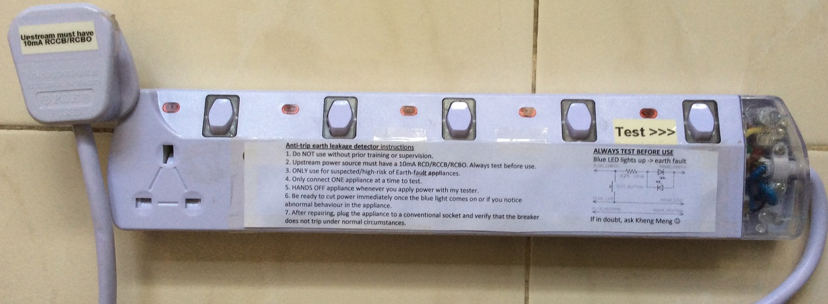
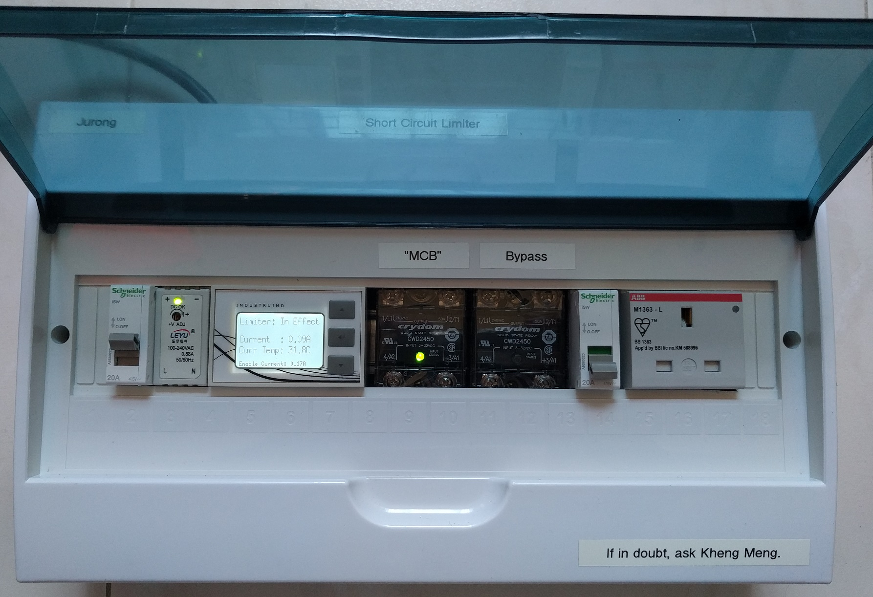
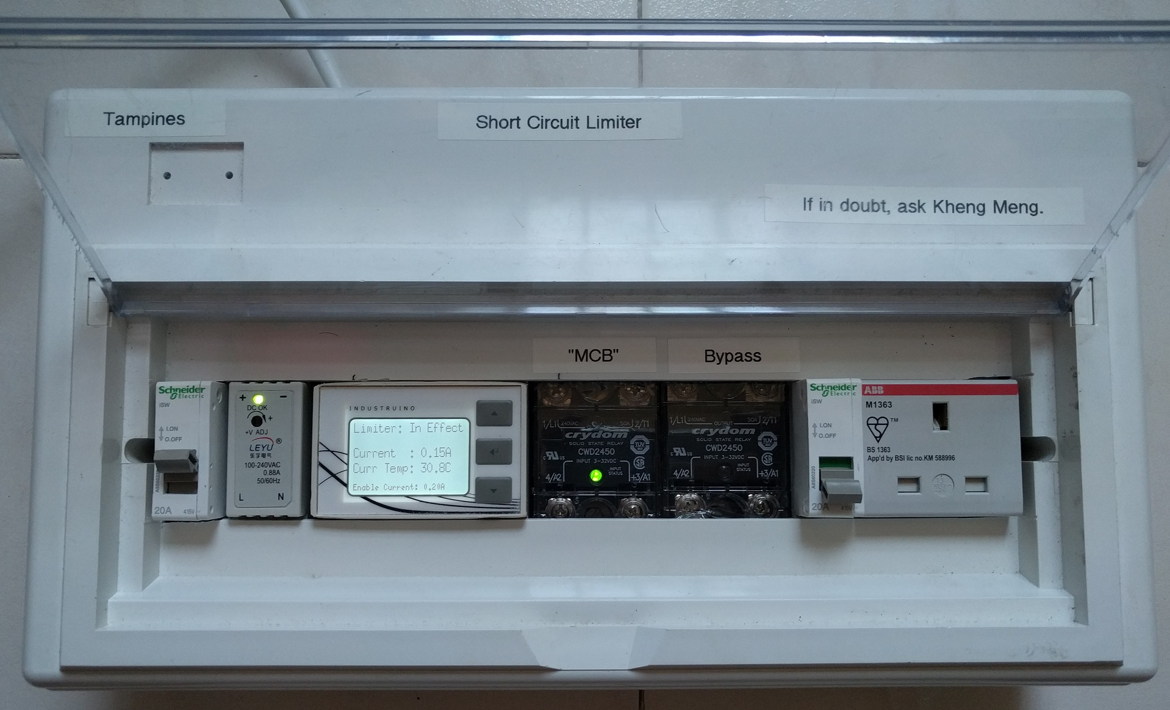
Repair Kopitiam Circuit Breaker Training
By: Yeo Kheng Meng (yeokm1@gmail.com)
https://github.com/yeokm1/repair-kopitiam-training-and-equipment
http://yeokhengmeng.com/2016/05/repair-kopitiam-speciality-electrical-tools/
http://yeokhengmeng.com/2017/07/repair-kopitiam-specialty-electrical-tools-part-2-short-circuit-limiter/
For Repair Kopitiam Training

Slide 2
Agenda
Knowledge Recap
Problems
Solution

Slide 3
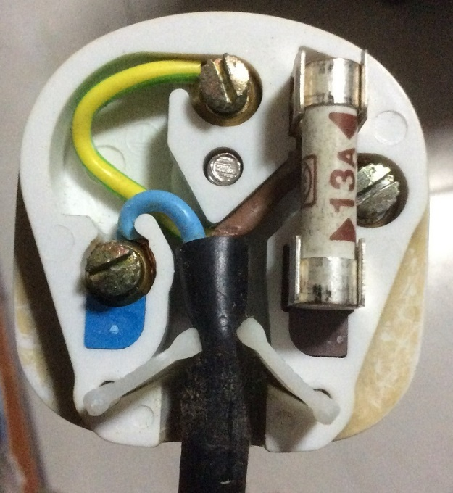
Inside the 3-pin mains plug (BS1363)
Earth
Yellow/Green
Connects to appliance’s external case, protects user from electric shock
Fuse
Blows on overcurrent
Usually 13A
Live
Brown/Red
Source of power
Neutral
Blue/Black
Completes the circuit to generator
Tied to ground at power distribution box to ensure stable 0V

Slide 4
Earth connections: Normal operation
Kettle
Mains Live
Fuse
230V
AC ~
Mains Neutral
Mains Earth
Earth

Slide 5
Live wire touches case
X
Kettle
Mains Live
Fuse
230V
AC ~
Mains Neutral
Mains Earth
Earth

Slide 6
What if there is no Earth wire?
Kettle
Mains Live
Fuse
230V
AC ~
Mains Neutral
Earth

Slide 7
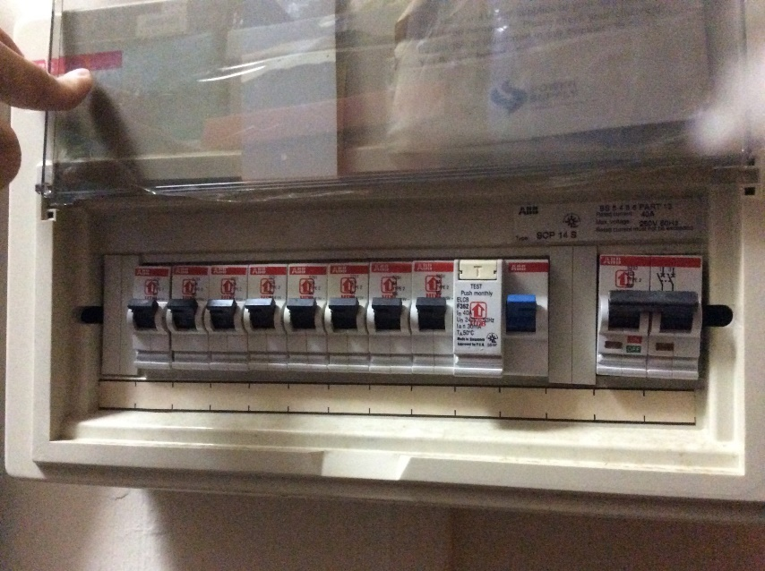
MCB + RCCB Circuit Breakers
MCB
RCCB
Residual Current Circuit Breaker (RCCB)
What it does? Breaks the circuit on earth fault
Cause: Current leakage to Earth
When?: Breaks when current difference between
(|live| - |neutral|)> 30mA threshold
Miniature Circuit Breakers (MCBs)
Breaks the circuit on overcurrent eg. short circuit

Slide 8
Circuit breaker arrangement
Mains Live
Kettle
MCB
RCCB
Fuse
230V
AC ~
Mains Neutral
Mains Earth
Earth
Residual Current Circuit Breaker (RCCB)
What it does? Breaks the circuit on earth fault
Cause: Current leakage to Earth
When?: Breaks when current difference between
|live – neutral|> 30mA threshold
Miniature Circuit Breakers (MCBs)
Breaks the circuit on overcurrent eg. short circuit

Slide 9
Residual Current Circuit Breaker with Overload Protection (RCBO)
Mains Live
Kettle
RCBO
Fuse
230V
AC ~
Mains Neutral
Mains Earth
Earth
RCBO = RCCB + MCB

Slide 10
Blackout recovery procedure
Why? Overcurrent or earth-leakage detected
Turn off every electrical device
Flip breaker to ON
Turn on ONE device at a time. If it trips again, you have found your spoilt device.
Prioritise simple devices like lamps/ovens.
Computers and refrigerators are sensitive to repeated power cycles.
Unplug that spoilt appliance
Flip breaker back on.

Slide 11
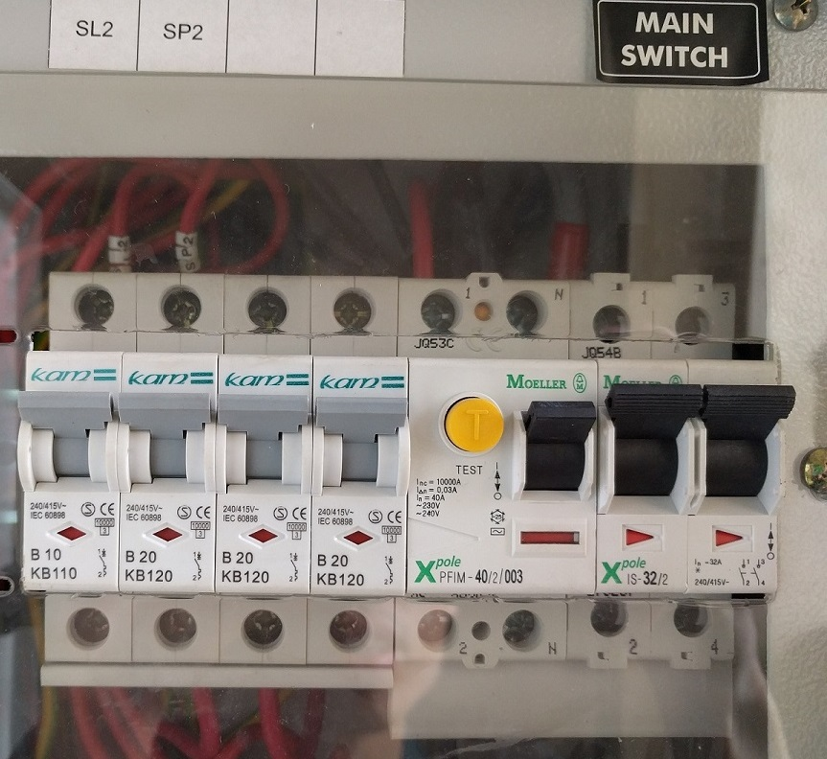
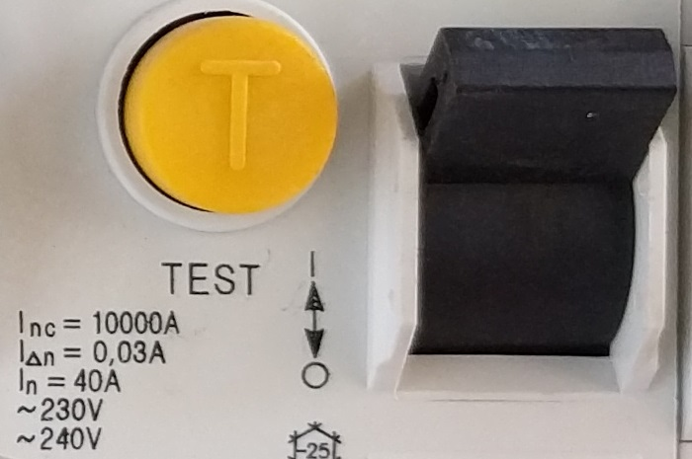
Problem 1: Safety
Typical I_{△n} = 30ma threshold for earth leakage which is still dangerous
Balance between safety and nuisance trips
But RK always deals with high-risk faulty appliances…

Slide 12
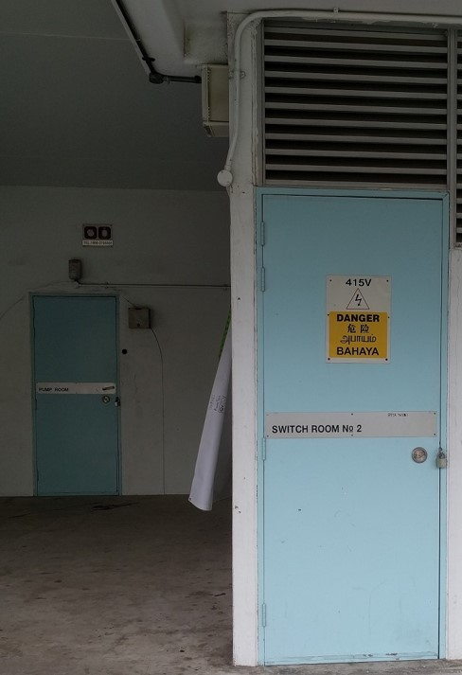
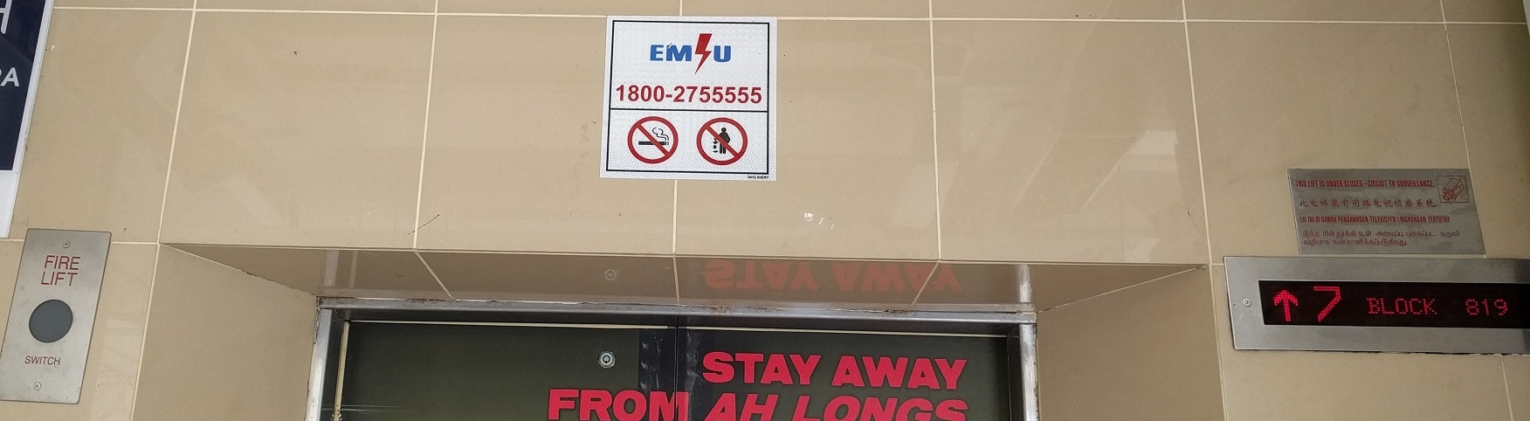
Problem 2: Inaccessible onsite breaker
Circuit breaker inside locked electrical room
Call Essential Maintenance Service Unit (EMSU) to unlock
30-60 mins response time

Slide 13
Problem 3: Inconvenience of breaker trip
Breaker trips affect the work of others eg. Sewing machine

Slide 14
Solution for RCCB earth-leakage trips
Jurong
Tampines
Increased safety due to more sensitive 10mA trip rating
Isolates earth trips to this device, onsite breaker RCCB does not trip
Demo video: https://www.youtube.com/watch?v=h-DokWP5Kic

Slide 15
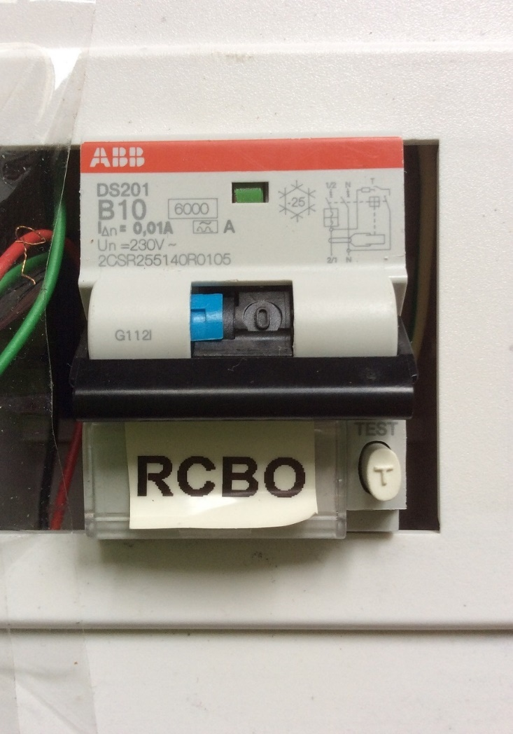
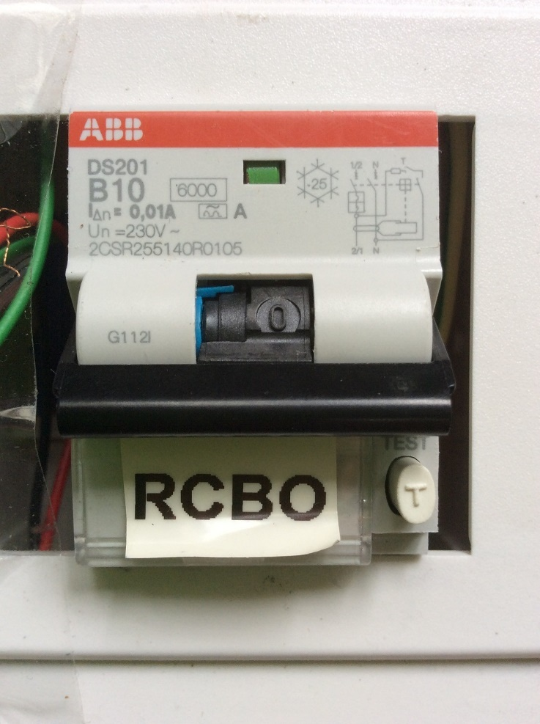
RCBO trip status + Demo
Earth trip: Switch and blue tab is down
Overload trip: Only switch is down

Slide 16
Solution for MCB short-circuit trips
Jurong
Tampines
Isolates short-circuits to this device, onsite breaker MCB should trip lesser
Connect DOWNSTREAM to RCBO

Slide 17
Solution to prevent MCB trip (Demo)
Video URL: https://www.youtube.com/watch?v=VpU6cOnxy0s
20 seconds startup time to let current measurement settle. Notice the left relay is kept off till startup is done.
Turn on a lamp: There is a 1 second delay between turning on the lamp and the second relay being turned on. Also notice the display backlight turns on and the buzzer buzzes once.
Turn off the lamp: The display backlight turns off immediately and the buzzer buzzes twice.
Repeat steps 2 and 3 for the hair dryer. Notice the motor sound is lower during the 1 second period.
Short circuit with a cable with its live and neutral pins shorted. The moment the switch is turned on, the device cuts off power to the outgoing socket. The buzzer also buzzes for a long 2 seconds. Notice the onsite MCB in the room did not trip as the device is still on.
Reset the device with just a simple button press.

Slide 18
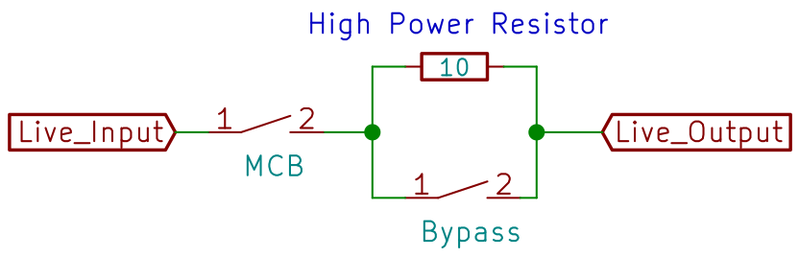
Behaviour State 0
MCB Relay
Bypass Relay
10-ohm resistor

Slide 19
Behaviour State 1
MCB Relay Closed
Bypass Relay Open

Slide 20
Behaviour State 2a
Appliance connected and 1 second of no short circuit
Bypass Relay closes -> Full current
If appliance turns off, go back to State 0

Slide 21
Behaviour State 2b
If short circuit happens, MCB relay opens
MCB relay closes only if user resets the system

Slide 22
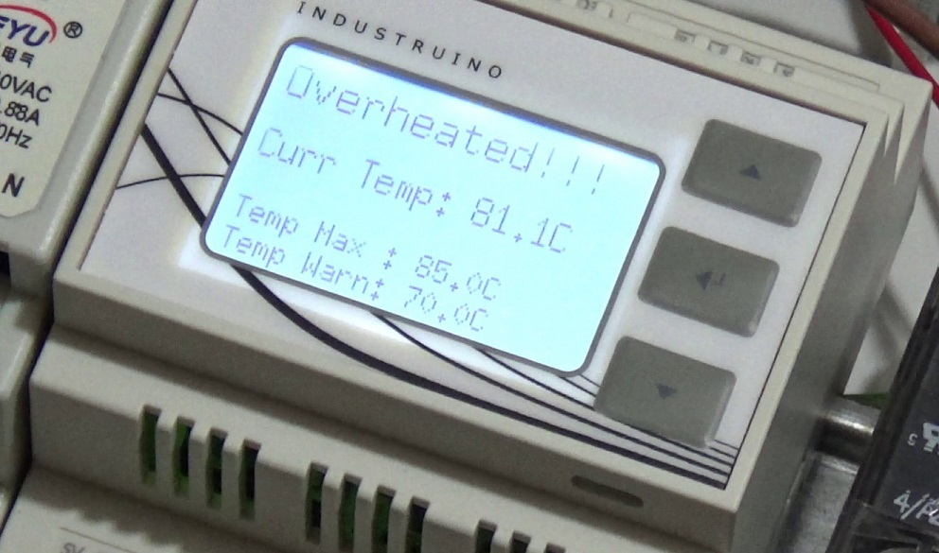
Resistor Overheat Alert
70°C buzzer/blink warning
85°C function ceased till temperature < 70°C
Video URL: https://www.youtube.com/watch?v=O4qB3WehqlA
Should not happen under normal cases

Slide 23
System weakness
Short Circuit after Resistor has been bypassed
Multiple downstream appliances

Slide 24
Test for Earth Leakage without tripping
anti-trip-earth-leakage-detector
Shows blue LED on earth fault without breaker trip
Does not interrupt the work of others
Preserves lifespan of RCBO
Familiarise with usage instructions beforehand
Demo video: https://www.youtube.com/watch?v=tSpie7baYFM

Slide 25
Questions
By: Yeo Kheng Meng (yeokm1@gmail.com)
https://github.com/yeokm1/repair-kopitiam-training-and-equipment
http://yeokhengmeng.com/2016/05/repair-kopitiam-speciality-electrical-tools/
http://yeokhengmeng.com/2017/07/repair-kopitiam-specialty-electrical-tools-part-2-short-circuit-limiter/

